Slide 1
Multi-agent Deep Reinforcement Learning for Optimal Product Allocation and Configuration
Porter Jenkins
Pennsylvania State University

Slide 2
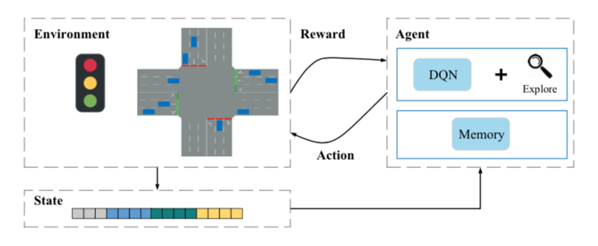
Introduction
Deep Reinforcement learning has shown to be effective for learning control policies over space and/or time
Traffic
Airline tickets
Ride-sourcing applications (uber, lyft)
Energy consumption
Computer systems
RL research can be difficult since agent needs to manipulate environment:
”In the wild” experimentation
Clear access to an accurate simulator
Other spatio-temporal areas can benefit from cutting-edge RL methods
Product placement in a physical retail environment
We have access to a 3 month, “in the wild” experiment
2 months to train agent
1 month test test agent

Slide 3
Problem Description
Action: Choose location
Many retailers/producers do not have good methodology to select where to place their product in a physical store
Once they’ve decided where, how to configure the product display decided pseudo-randomly, or by intuition
Clear objective (reward): sell more goods
Action: Choose configuration
Observe: Product sold

Slide 4
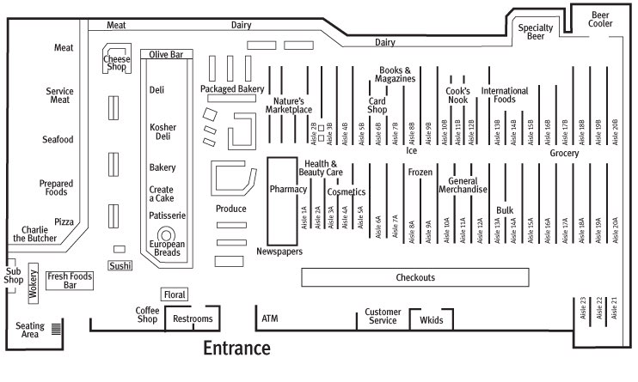
Action: Location Selection
Multiple, discrete locations within a store
Number and location
Competitive behavior

Slide 5
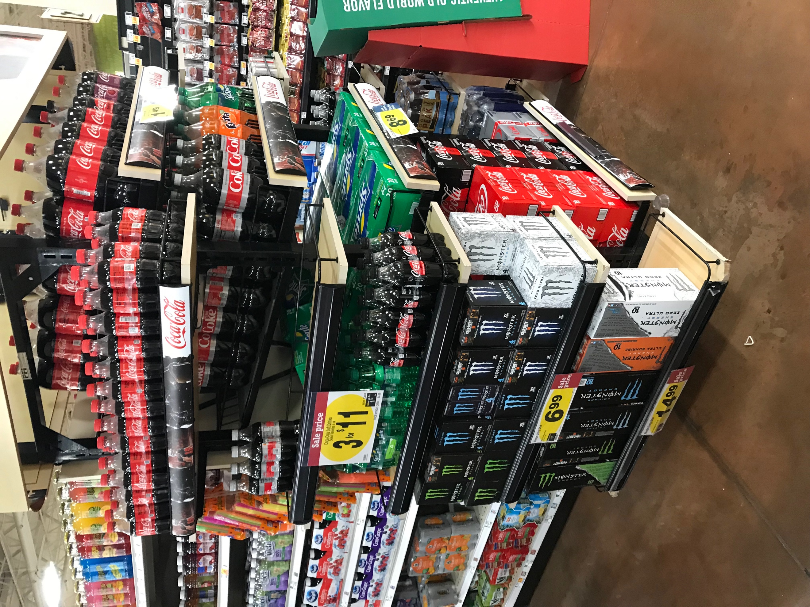
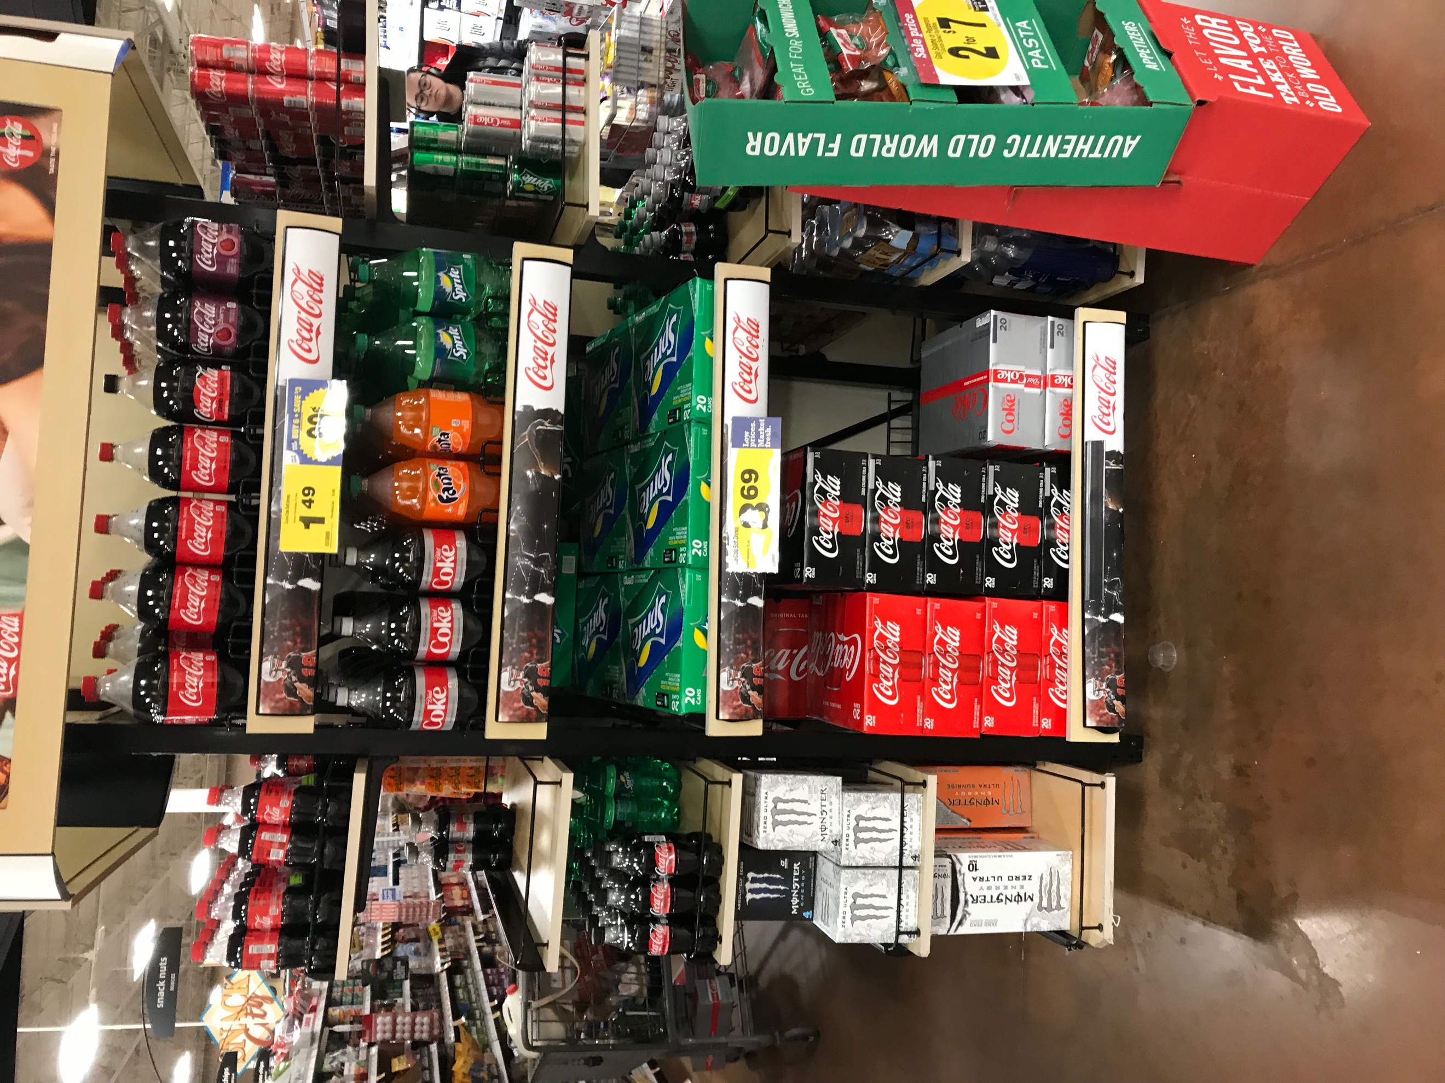
Action: Display Configuration
Action: Choose location
Which products?
Which locations?
How much product?
Learn from raw visual input
Photos of displays
Co-occurrence of products
Coke + candy
Coke + laundry detergent?

Slide 6
MDP with 2 Agents
Action: Choose location
Agent 1: Location Selector
Agent 2: Configuration Selector
State: Sequence of store layouts, seasonal/temporal dynamics of sales
State: Locations from Agent 1, Raw images representing state of configuration
Action: Add product, move products, product co-occurence
Action: Select k of N possible locations
Reward: Observe sales, how many items were removed from display
Reward: Observe sales, how many items were removed from display

Slide 7
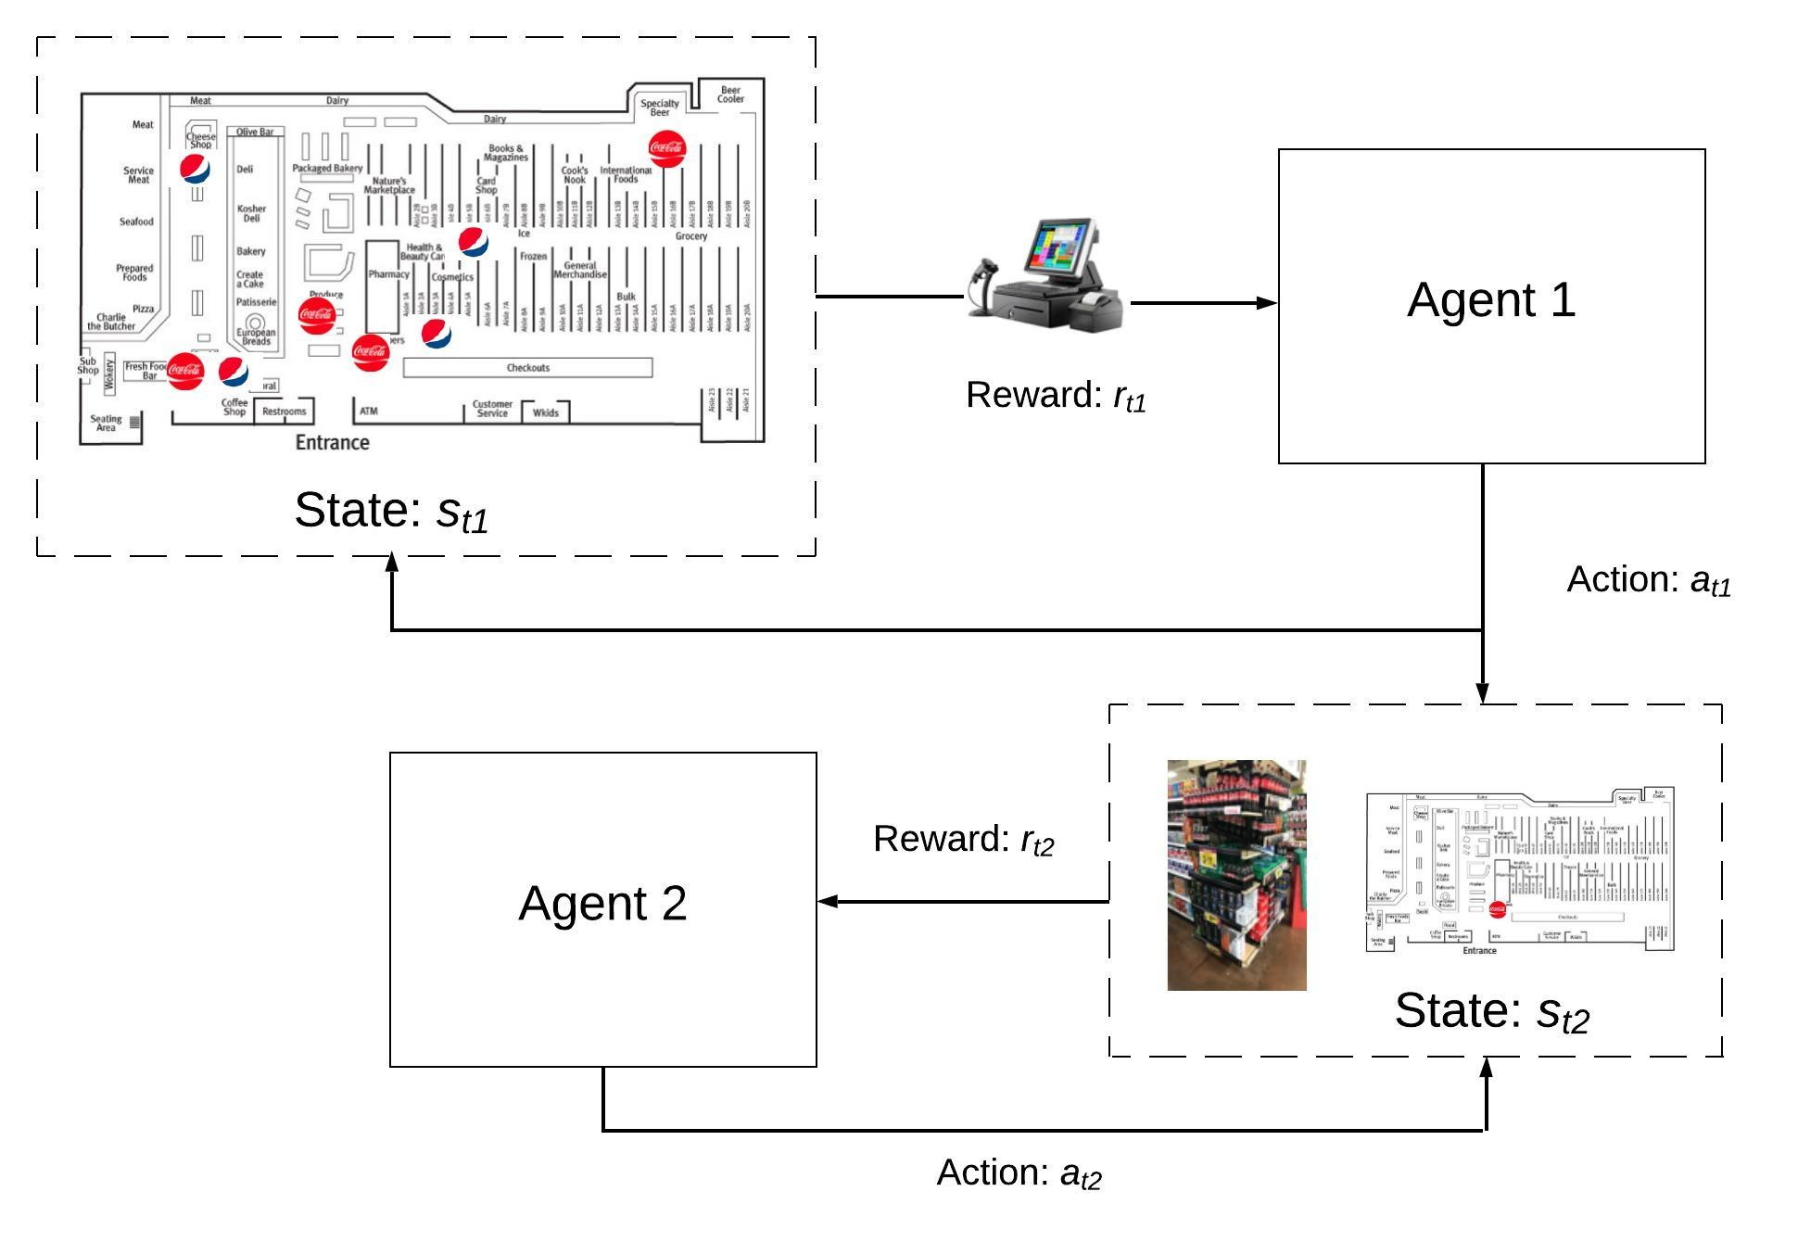
Action: Choose location

Slide 8
Proposed Experiments
Action: Choose location
“In the wild”
3 months
2 months train, 1 month test
Select ~6 stores (maybe depending on resource)
Chose stores with high degree of similarity to control for environmental factors
Control (2 stores):
Existing selection mechanisms (random/intuition)
Treatment 1 (2 stores):
Multi-agent RL approach
Treatment 2 (2 stores):
More simple, supervised learning approach
Compare product output of treatments to control

Slide 9
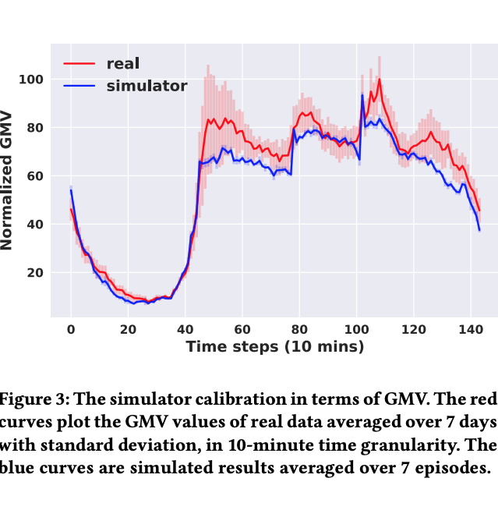
Phase 1: Collect Data, Build Simulator
We construct a simulator
Calibrate simulator to historical data
Validate that results of simulator match empirical distribution
Similar to Lin et al., KDD’18

Slide 10
Contributions
Action: Choose location
“In the wild” experiment to validate
Will require domain-specific adaptations of existing methods
Similar to Hua and Guanjie’s paper
New Network architecture
‘Memory palace’ idea
Some domain-specific considerations:
Layouts unique for each location
Strong seasonality
Co-occurrence
Competitive behavior (coke v pepsi)

